Slide 1
Unit 5: What’s Your Point?

Slide 2
CSI

Slide 3
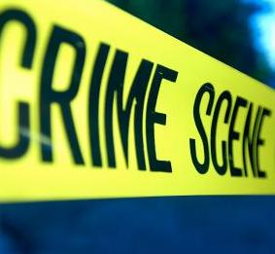
You are investigators
who have been called to the scene of a crime. Look for clues to determine what happened to the victim.

Slide 4
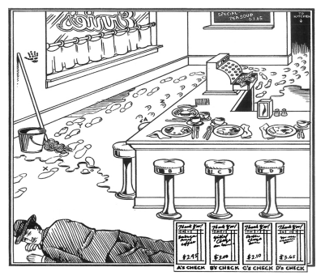
Take a close look at the picture. Make observations on your handout. Keep your eyes open for anything suspicious…

Slide 5
Let’s take a look at the case.

Slide 6
Which of the people in the lunchroom killed Joey?
Based on the evidence, Customer C is probably the killer. We can tell that Customer C is left handed from the silverware and the handprint on the wall. The murderer shot with his left hand; therefore, he is killer.

Slide 7
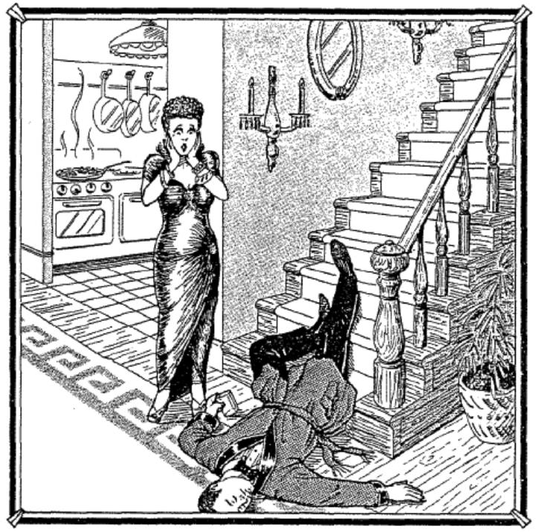
Investigators, we have another case…
Work with your small team of “investigators.”
Record observations from the crime scene
Read the case
Complete the task on the back of your handout
*You may want to consider: Can we believe what Queenie says? From watching crime shows, you may know that witnesses are not always reliable.

Slide 8
Notes:
Give students time to investigate the picture and fill out their evidence charts. After 5 minutes or so, they can come circle the clues on the Smartboard.

Slide 9
Now, connect the evidence and the rule to draw a conclusion. For example…
Evidence → Arthur still has a glass in his hand.
Prior Knowledge → I know when people fall down the stairs, they drop what they are carrying to save themselves.
Conclusion → Queenie is probably lying about him falling down the stairs.

Slide 10
Evidence | Prior Knowledge | Conclusion
What do you notice about the items on the wall?
 |  | If Queenie is guilty, she could not have killed her husband with force.
What did the autopsy report find?

Slide 11
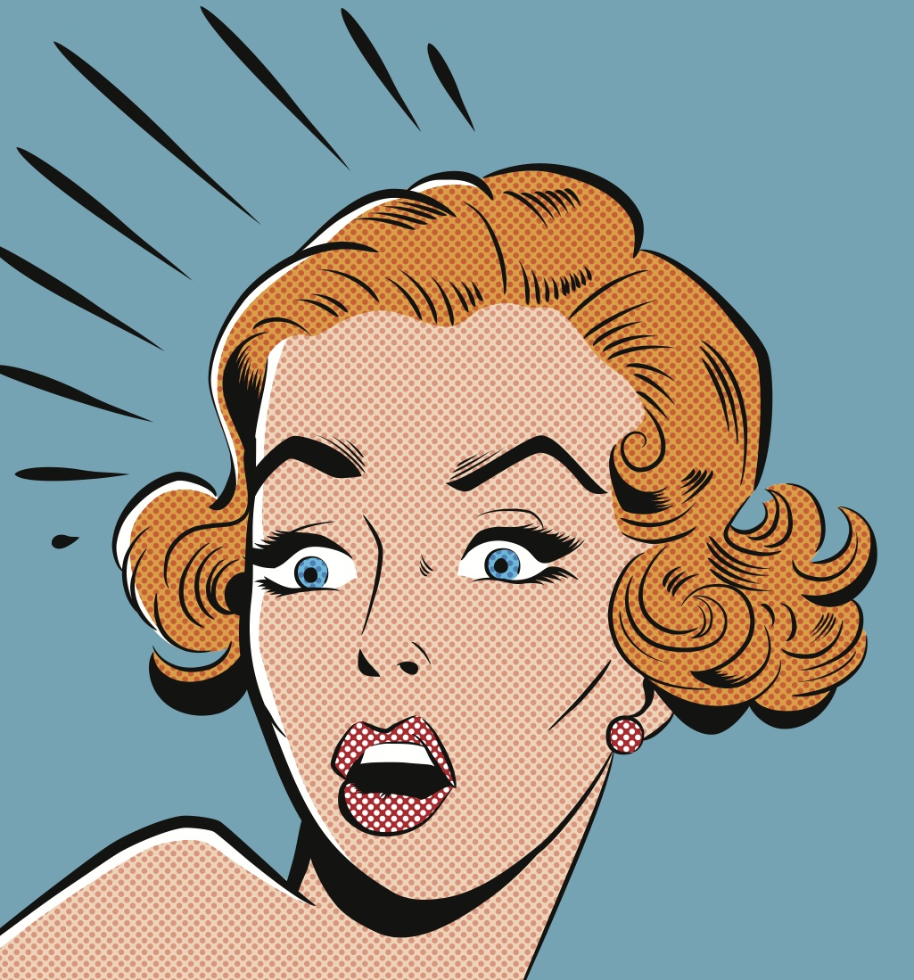
Evidence suggests Queenie poisoned her husband.

