Slide 1
Norse Mythology - Valkyries
Odin had 12 handmaidens called the Valkyries who could choose which killed warriors would go to Valhalla
Notes:
Image: By Creator:William T. Maud (William T. Maud, 1890) [Public domain], via Wikimedia Commons

Slide 2
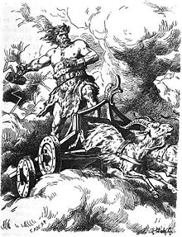
Norse Mythology - Thor
Thor was a hammer-wielding god and was associated with:
Thunder
Lightning
Storms
Oak trees
Strength
Protecting mankind
And more
Member of the Æsir
Notes:
Image: "Thor by Johannes Gehrts" by Eduard Ade - Felix Dahn, Therese Dahn, Therese (von Droste-Hülshoff) Dahn, Frau, Therese von Droste-Hülshoff Dahn (1901). Walhall: Germanische Götter- und Heldensagen. Für Alt und Jung am deutschen Herd. Breitkopf und Härtel.. Licensed under Public Domain via Commons - https://commons.wikimedia.org/wiki/File:Thor_by_Johannes_Gehrts.jpg#/media/File:Thor_by_Johannes_Gehrts.jpg

Slide 3
Norse Mythology - Thor
Some sources identify Thor as the son of Odin and Fjörgyn
Mjölnir was the hammer of Thor and was depicted as a fearsome weapon capable of leveling mountains
The name “Thursday” comes from the Old English language and means “Thor’s Day”
Notes:
Thor wields the mountain-crushing hammer, Mjölnir, wears the belt Megingjörð and the iron gloves Járngreipr, and owns the staff Gríðarvölr.
Image: "Thor by Johannes Gehrts" by Eduard Ade - Felix Dahn, Therese Dahn, Therese (von Droste-Hülshoff) Dahn, Frau, Therese von Droste-Hülshoff Dahn (1901). Walhall: Germanische Götter- und Heldensagen. Für Alt und Jung am deutschen Herd. Breitkopf und Härtel.. Licensed under Public Domain via Commons - https://commons.wikimedia.org/wiki/File:Thor_by_Johannes_Gehrts.jpg#/media/File:Thor_by_Johannes_Gehrts.jpg

Slide 4
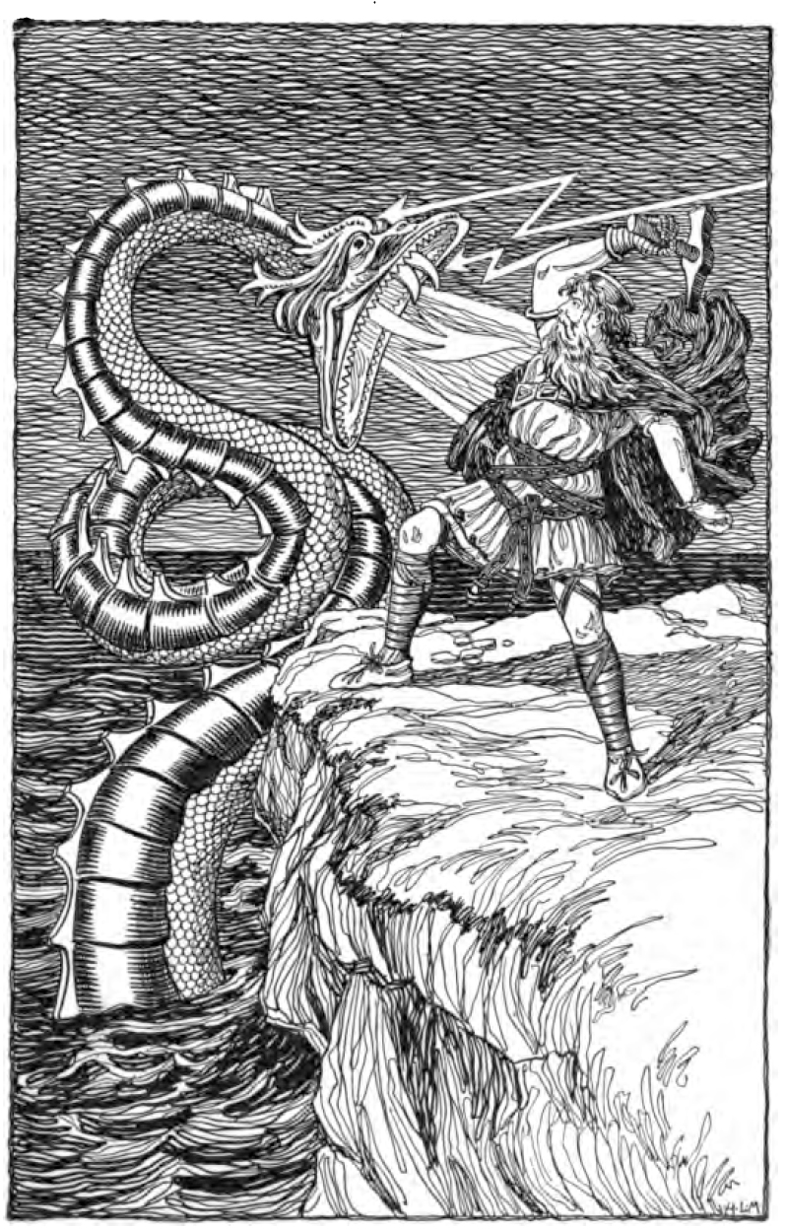
Norse Mythology - Jörmungandr
Jörmungandr, a sea serpent, was Thor’s arch-enemy
Jörmungandr’s name is Old Norse for “huge monster”
It was said he grew so large that he reached around the Earth and grabbed his own tail, and that when he lets go, the world will end
Notes:
Image: "Thor Fighting the Serpent by H. L. M" by Signed "H. L. M." - Foster, Mary H. 1901. Asgard Stories: Tales from Norse Mythology. Silver, Burdett and Company. Page 105.. Licensed under Public Domain via Wikimedia Commons - https://commons.wikimedia.org/wiki/File:Thor_Fighting_the_Serpent_by_H._L._M.jpg#/media/File:Thor_Fighting_the_Serpent_by_H._L._M.jpg

Slide 5
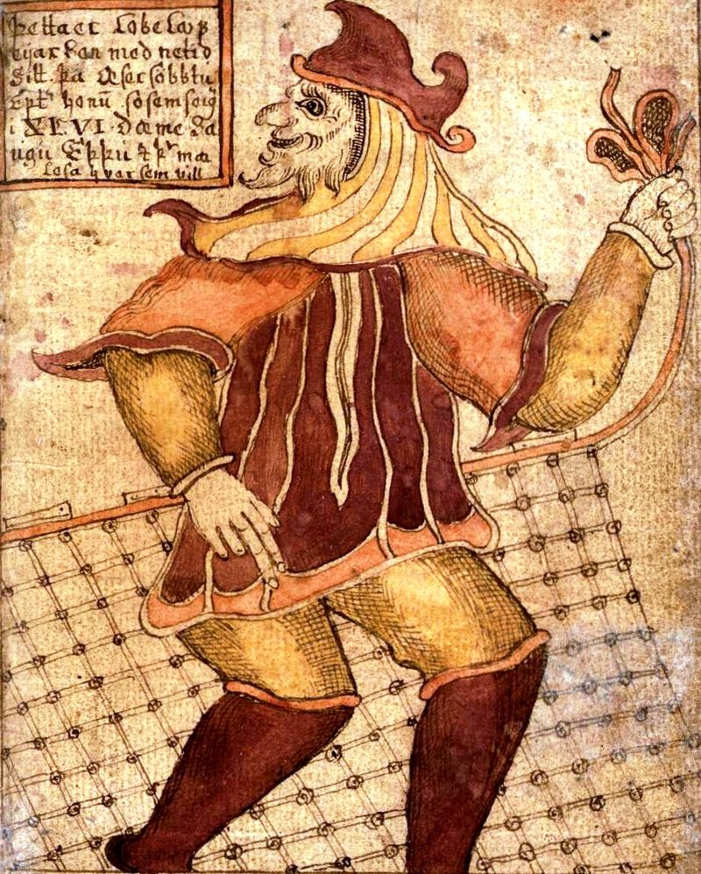
Norse Mythology - Loki
Loki was considered to be a “trickster god” who was sometimes good and sometimes bad
Member of the Æsir
He could change forms
His good relations with the gods ended when he killed Odin’s son Baldr, who was the god of light and purity
Notes:
Image: "Processed SAM loki". Licensed under Public Domain via Commons - https://commons.wikimedia.org/wiki/File:Processed_SAM_loki.jpg#/media/File:Processed_SAM_loki.jpg

Slide 6
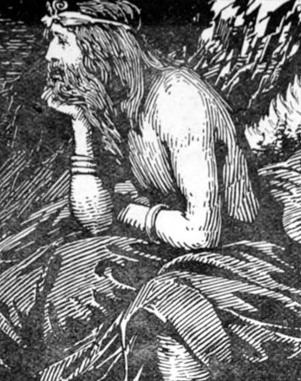
Norse Mythology – Njörðr
The god Njörðr is associated with the sea, wind, fishing, wealth, and growing crops
Member of the Vanir
Father to the god Freyr and the goddess Freyja
Notes:
Njörðr fathered the deities Freyr and Freyja by his unnamed Vanir sister, and not with his wife Skaði.
Image: adapted from By W.G. Collingwood (1854 - 1932) [Public domain], via Wikimedia Commons

Slide 7
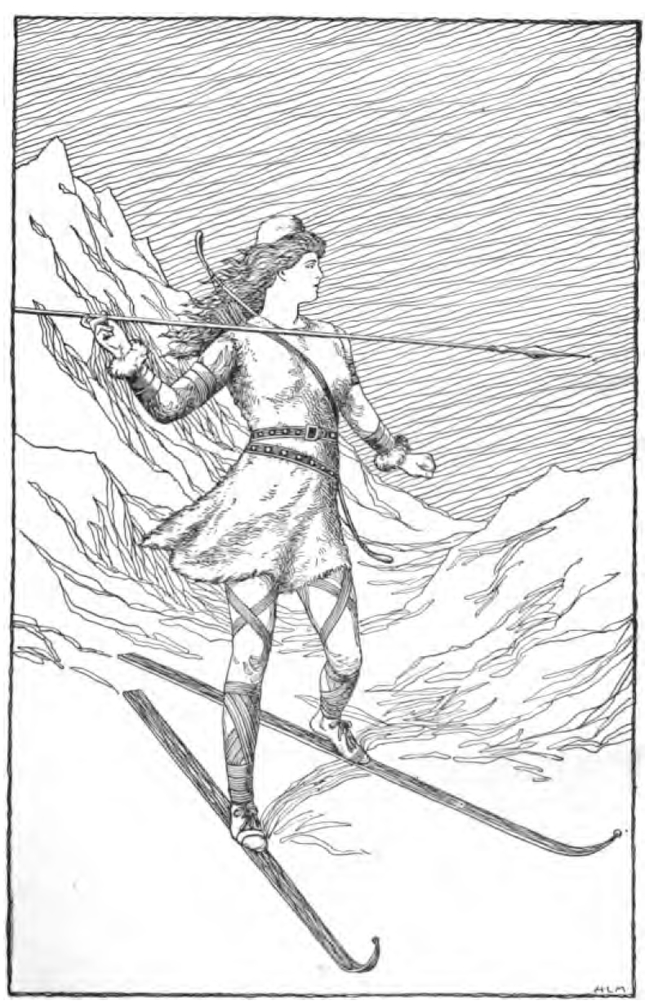
Norse Mythology – Skaði
Skaði is a goddess associated with bowhunting, skiing, winter, and mountains
Skaði is Jötunn, which is a race of giants
She is Njörðr’s wife
Notes:
Skaði is sometimes spelled as Skadi, Skade, or Skathi
Image: "Skadi Hunting in the Mountains by H. L. M" by Signed "H. L. M." - Foster, Mary H. 1901. Asgard Stories: Tales from Norse Mythology. Silver, Burdett and Company. Page 79.. Licensed under Public Domain via Commons - https://commons.wikimedia.org/wiki/File:Skadi_Hunting_in_the_Mountains_by_H._L._M.jpg#/media/File:Skadi_Hunting_in_the_Mountains_by_H._L._M.jpg

Slide 8
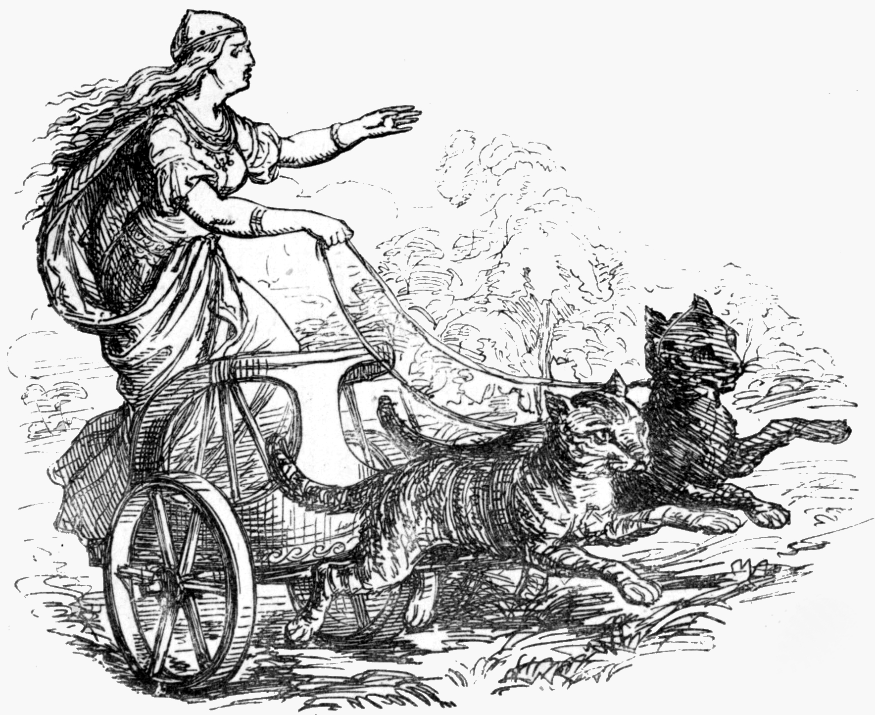
Norse Mythology – Freyja
Freyja is a goddess associated with love, beauty, war, death, and more
She rides a chariot pulled by two cats
Member of the Vanir
Notes:
Freyja also possesses a cloak of falcon feathers, and has two daughters, Hnoss and Gersemi.
Image: By Ludwig Pietsch (1824-1911) [Public domain or Public domain], via Wikimedia Commons

Slide 9
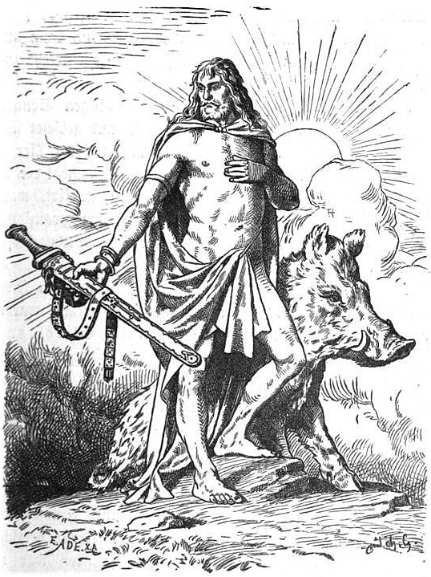
Norse Mythology – Freyr
Freyr is associated with prosperity, sunshine, and fair weather
Member of the Vanir
He is especially associated with Sweden and is seen as an ancestor of the Swedish royal house
Notes:
Image: Eduard Ade [Public domain], via Wikimedia Commons

Slide 10
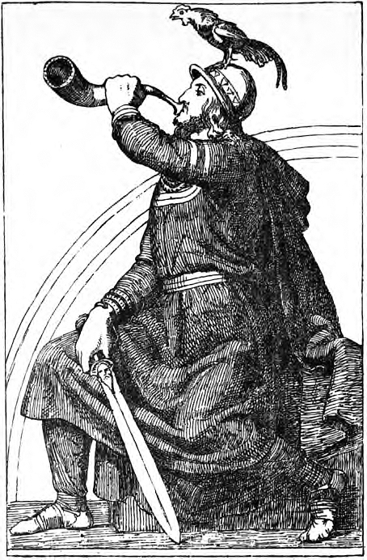
Norse Mythology - Heimdallr
Heimdallr is a god who is known for his foreknowledge, and keen eyesight and hearing
Member of the Æsir
Guards the Bifröst, a rainbow bridge that connects the world to Asgard
Watches for the beginning of Ragnarök
Notes:
Heimdallr is pictured with the rooster Gullinkambi, who is one of three roosters whose crowing is said to signal the events of Ragnarök.
Image: "Heimdal (1907) by J. T. Lundbye" by Johan Thomas Lundbye - Published in Johansen, P. Nordisk Oldtid og Dansk Kunst. I komission hos H. Hagerup.. Licensed under Public Domain via Commons - https://commons.wikimedia.org/wiki/File:Heimdal_(1907)_by_J._T._Lundbye.jpg#/media/File:Heimdal_(1907)_by_J._T._Lundbye.jpg

Slide 11
Norse Mythology – Ragnarök
In Norse Mythology, Ragnarök is a series of future events in which the world as the Norse know it ends
Odin, Thor, Loki, and other gods and goddesses are killed
The world is submerged in water and reemerges to be populated by two human survivors
Notes:
Image: Johannes Gehrts [Public domain], via Wikimedia Commons

Slide 12
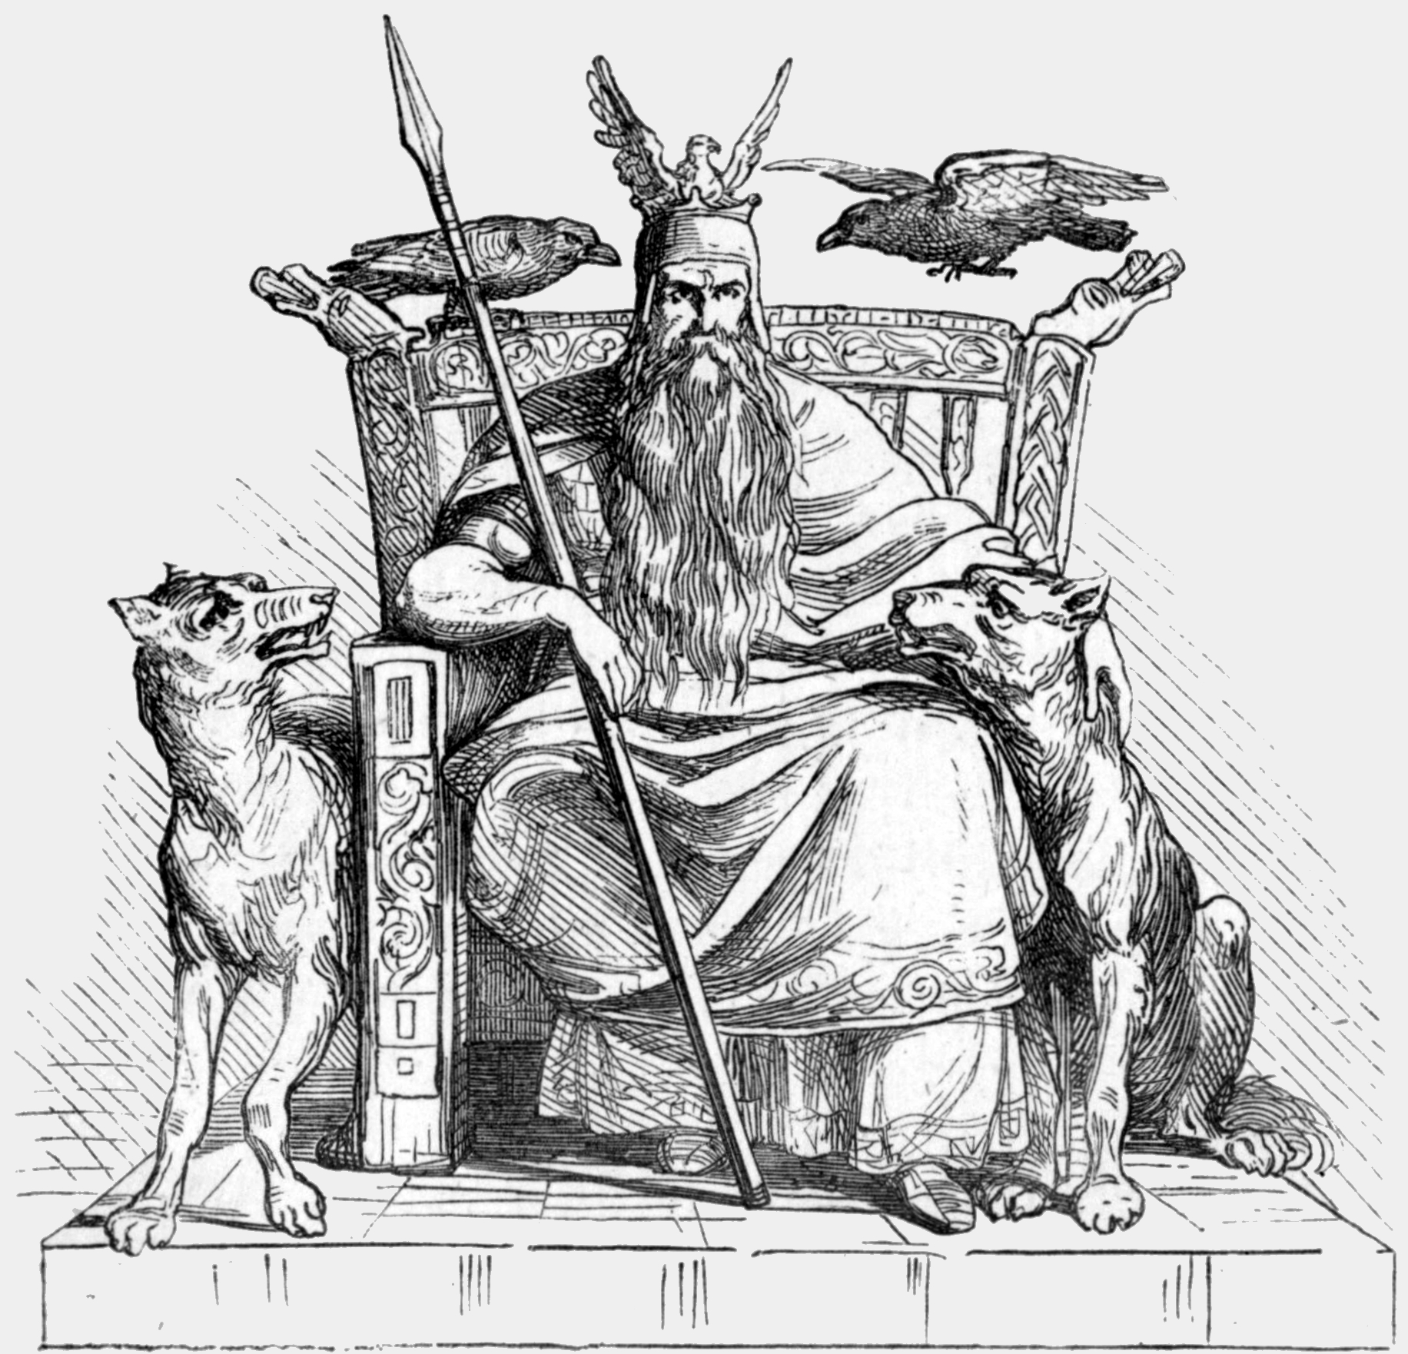
Norse Mythology - Odin
Odin was a Norse god associated with:
Healing
Death
Royalty
Knowledge
And more
Member of the Æsir
He is often depicted with one eye and with a Raven
Notes:
According to Norse legend, Odin sacrificed his eye to Mímir, a figure renowned for his knowledge and wisdom, in exchange for wisdom
Image: Ludwig Pietsch [Public domain], via Wikimedia Commons

Slide 13
Norse Mythology - Valkyries
Odin had 12 handmaidens called the Valkyries who could choose which killed warriors would go to Valhalla
Notes:
Image: By Creator:William T. Maud (William T. Maud, 1890) [Public domain], via Wikimedia Commons

