Slide 1
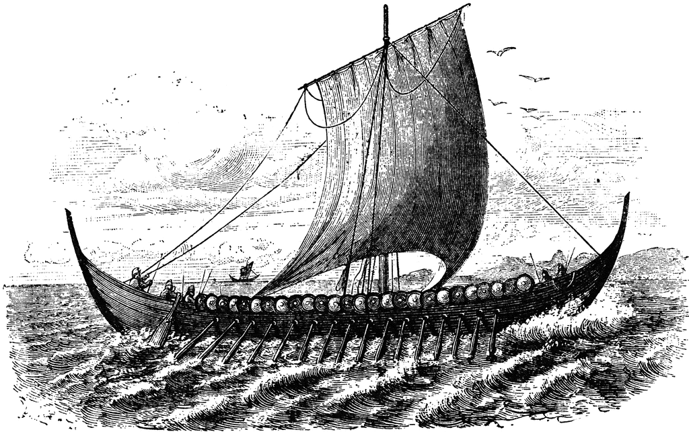
Who Were the Norse?
The term “Norse” often refers to medieval Scandinavia, its inhabitants, and its language
Notes:
Image: By unknown, author is A.E. Nordenskiold [Public domain], via Wikimedia Commons

Slide 2
Who Were the Norse?
The Vikings were seafarers who spoke the Old Norse Language
The name “Viking” possibly comes from the Old Norse term víkingr, which was a word for “pirate”
Notes:
The term “víkingr” was used as a verb to describe when men would go on raids.
Another possibility for the origin of the term Viking is from the feminine vík, meaning "creek, inlet, small bay”. Various theories have also been offered that the word viking may be derived from the name of the historical Norwegian district of Viken (or Víkin in Old Norse), meaning "a person from Viken".

Slide 3
Norse Mythology
Before the Norse were converted to Christianity during the Middle Ages, they had their own complex religion
It didn’t have a true name – those who practiced it called it “tradition”
Notes:
Image: Oscar Wergeland [Public domain], via Wikimedia Commons

Slide 4
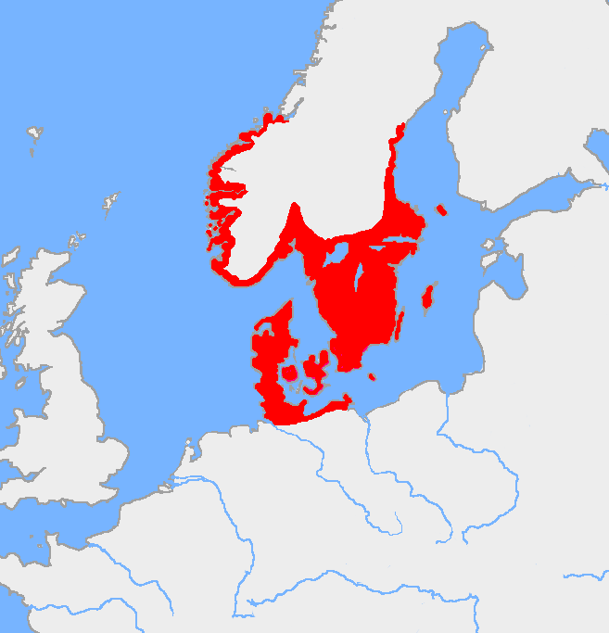
Norse Mythology
The “tradition” was practiced on the Scandinavian Peninsula and in northern parts of present-day Denmark and Germany
Notes:
Image: "Nordic Bronze Age". Licensed under Public Domain via Commons - https://commons.wikimedia.org/wiki/File:Nordic_Bronze_Age.png#/media/File:Nordic_Bronze_Age.png

Slide 5
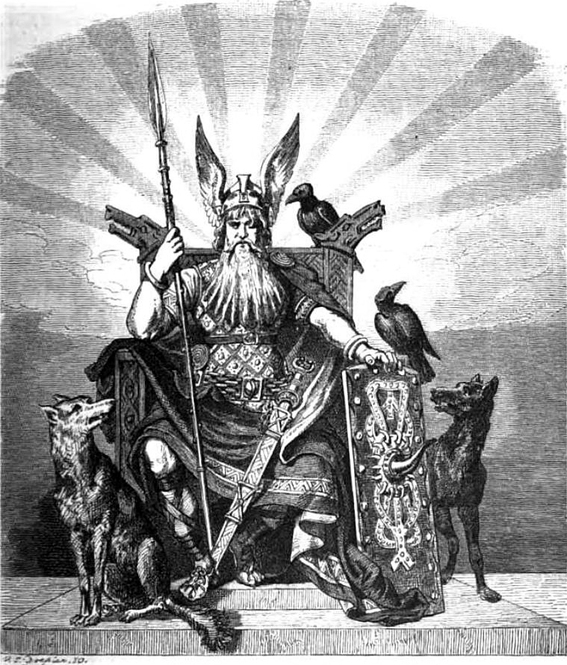
Norse Mythology
Like other religions and mythologies at the time, it gave life meaning and helped people understand the world
Notes:
Image: By Carl Emil Doepler (1824-1905) [Public domain], via Wikimedia Commons

Slide 6
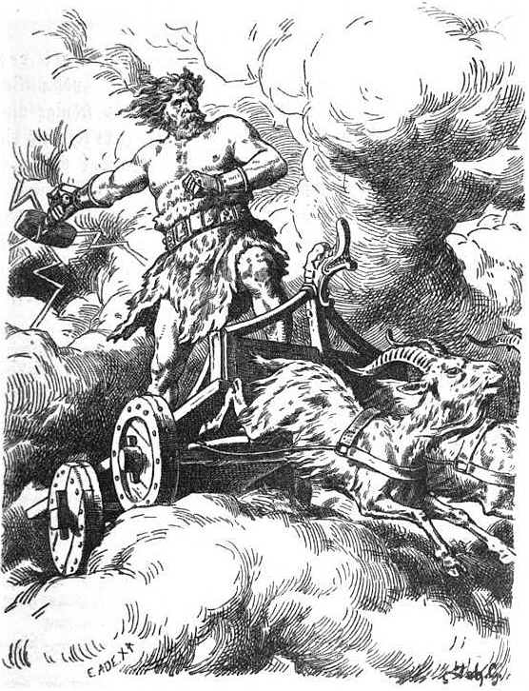
Norse Mythology
Norse mythology has tales of various gods, beings, and heroes
The Norse believed there were multiple gods and that animals had spirits
Notes:
Pictured: Thor
Image: Eduard Ade [Public domain], via Wikimedia Commons

Slide 7
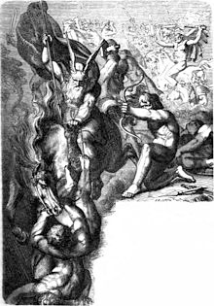
Norse Mythology
Norse gods were broken into two groups
The Vanir were associated with wisdom, nature, magic, and the ability to see the future
The other group was the Æsir (pronounced ICE-ear), who were associated with power and war and included the well-known gods Odin and Thor
The two groups would go to war
After their war they unified into one group
Depiction of the Æsir
fighting the Vanir
Notes:
Image: Carl Ehrenberg [Public domain], via Wikimedia Commons

Slide 8
Norse Mythology
Death and battle play important roles in Norse mythology
Half of those who died in battle would travel to Valhalla, an enormous hall in Asgard
Notes:
Image: "Walhalla (1896) by Max Brückner" by Max Brückner (1836-1919) - [1]. Licensed under Public Domain via Commons - https://commons.wikimedia.org/wiki/File:Walhalla_(1896)_by_Max_Br%C3%BCckner.jpg#/media/File:Walhalla_(1896)_by_Max_Br%C3%BCckner.jpg

Slide 9
Norse Mythology
Asgard is home to the Æsir gods and is ruled by Odin and his wife, Frigg
At Valhalla, the dead join with others who have died in combat to prepare to aid Odin for a final battle
Notes:
The other half traveled to Fólkvangr, a field ruled over by the goddess Freyja
Image: "Walhalla (1896) by Max Brückner" by Max Brückner (1836-1919) - [1]. Licensed under Public Domain via Commons - https://commons.wikimedia.org/wiki/File:Walhalla_(1896)_by_Max_Br%C3%BCckner.jpg#/media/File:Walhalla_(1896)_by_Max_Br%C3%BCckner.jpg

Slide 10
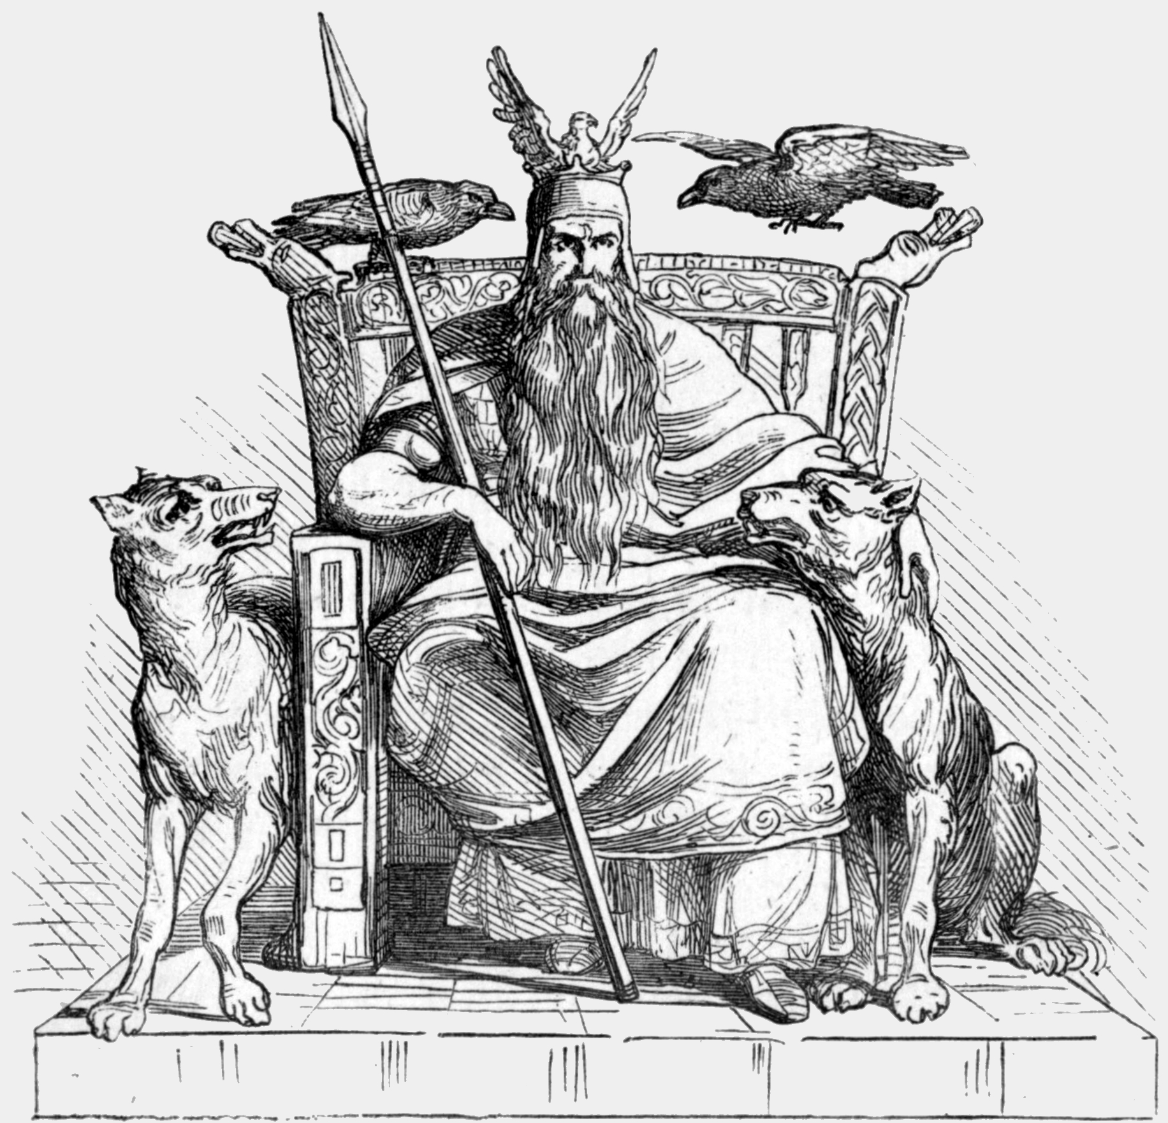
Norse Mythology - Odin
Odin was a Norse god associated with:
Healing
Death
Royalty
Knowledge
And more
Member of the Æsir
He is often depicted with one eye and with a Raven
Notes:
According to Norse legend, Odin sacrificed his eye to Mímir, a figure renowned for his knowledge and wisdom, in exchange for wisdom
Image: Ludwig Pietsch [Public domain], via Wikimedia Commons

